Slide 1
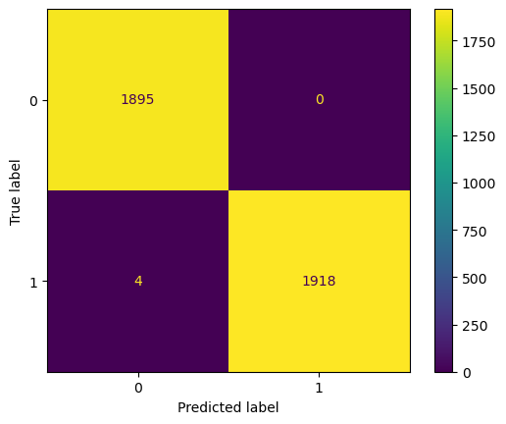
Enhancing Response Time and System Efficiency through Machine Learning
An Executive summary report for Tik tok by the data analytics team
This project aimed to increase response time and system efficiency by automating the initial stages of the claims process. The goal was achieved by developing a machine learning model that can accurately classify videos reported as claims or opinions based on various user engagement metrics.
The current claims process involves manual review of videos, which is time-consuming and prone to errors. This project sought to address this issue by leveraging machine learning techniques to automate the initial stages of the claims process.
We developed a machine learning model using the Random Forest algorithm and XGBoost. The model was trained on a dataset containing user video counts and user transcription text. The model was able to accurately classify videos reported as claims or opinions with a validation score of 0.996.
Performance of champion model - tuned random forest model on test holdout data.
The model considered several factors such as video duration, view count, like count, share count, download count, comment count, text length, author ban status, verified status, and numerical representatives of video transcription text. The model performed exceptionally well, with almost no false positives and very little false negatives.
Ethical Considerations.
The model was trained on data collected from TikTok, a platform that requires users to give consent for their data to be used. All data used in this project complies with TikTok privacy policy and terms of service. The model does not contain any personally identifiable information, and all data used was anonymized to protect user privacy.
Image Alt-Text Here
Going forward, we recommend an adoption of the model with continuous model training to ensure the model remains effective as trends and behaviors change over time. Regular monitoring of the model's performance and making necessary adjustments is also crucial. While automation can save time and effort, it's important to have a human in the loop for critical decisions. The model should be used as a tool to assist decision-making, not replace it entirely.

